Slide 1
An effective parameter optimization with radiation balance constraint in Atmospherical Models
吴利

Slide 2
Content
1 Introduction
Uncertainty of physical parameters
(2) Current research status and problem of parameter calibration methods
(3) Radiation imbalance in climate model
2 Method
(1) New algorithm for climate models
3 Study Cases
CESM1.2.1_CAM5
4 results
(1)Problem case
(2) Optimal case

Slide 3
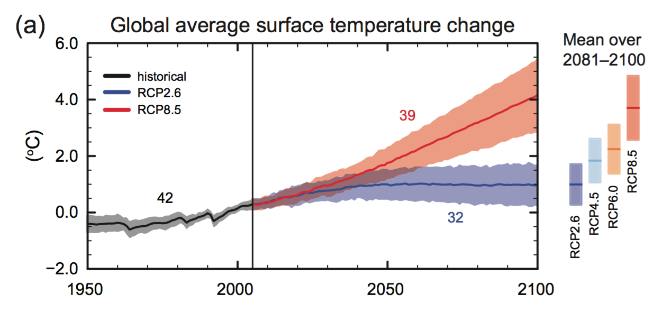
Uncertainty of physical parameters
不同模拟的温度差别（℃）
图片来自IPCC AR5
不同模拟场景
The impact of the uncertainty of the physical parameters on the model simulation is enormous.
Notes:
Representative Concentration Pathways. For CMIP5 a different experimental design was proposed in which the core simulations use prescribed RCPs of atmospheric CO2 and other GHGs (Moss et al., 2010).
其中的一个模式通过改变相应参数的取值，稳定积分后，温度模拟的差别，同样达到了2°左右。在一定程度上说明了物理参数的不确定。。。

Slide 4
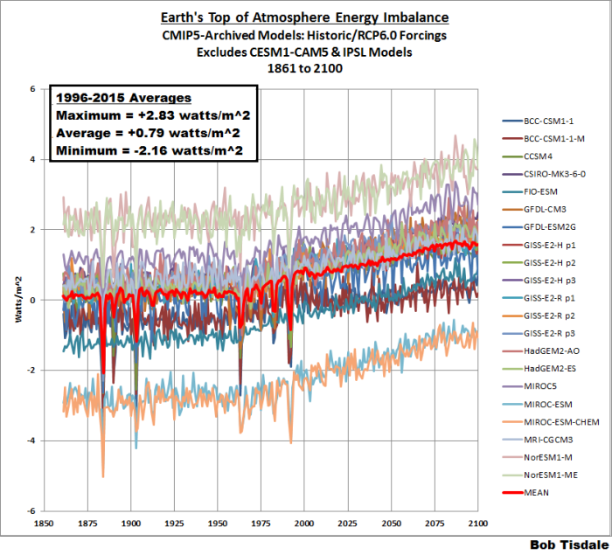
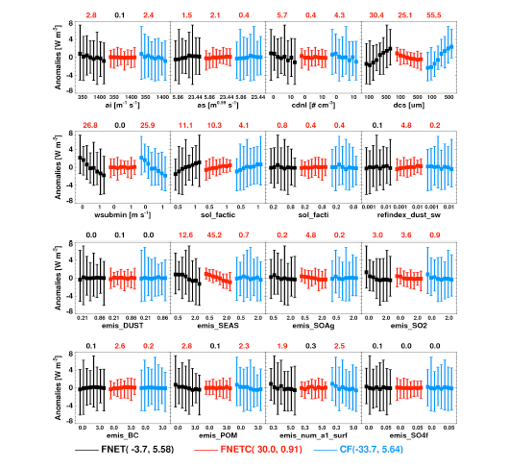
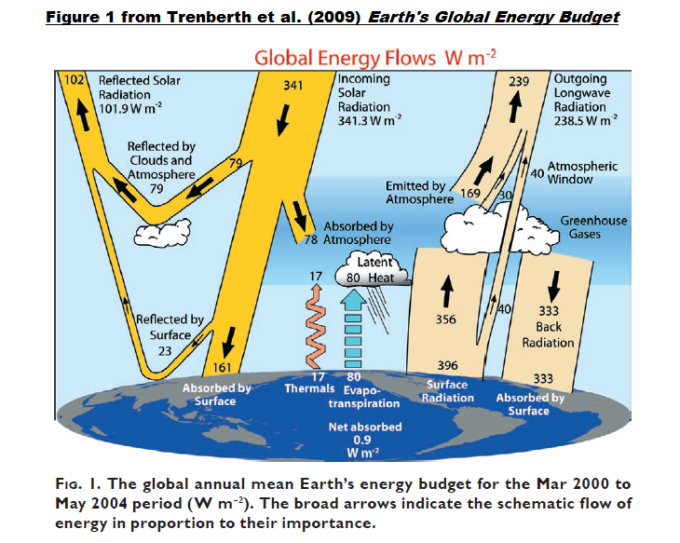
Radiation Imbalance in climate model
This energy balance tuning is crucial since a change by 1 W/m2 of the global energy balance produces typically a change of about 0.5 to 1.5 K in the global mean surface temperature in coupled simulations^{[1].}
Hourdin, F., T. Mauritsen, A. Gettelman, J.-C. Golaz, V. Balaji, Q. Duan, D. Folini, D. Ji, D. Klocke, Y. Qian, et al. (2017), The art and science of climate model tuning, Bull. Amer. Meteor. Soc., 98,589–602, doi:10.1175/BAMS-D-15-00135.1.

Slide 5
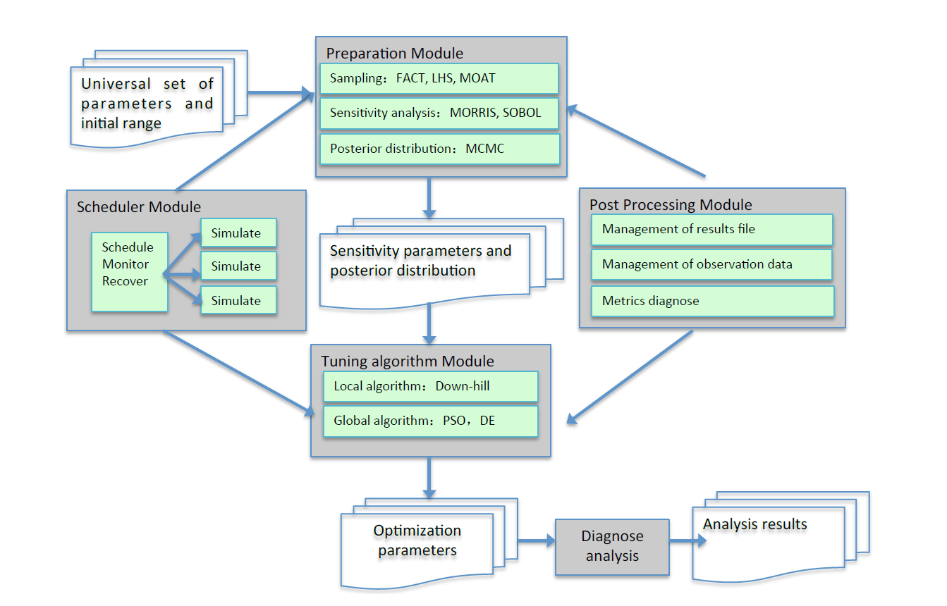
Current research status and problem of parameter calibration methods
SSAA
The automatic parameter calibration method can improve the overall performance of the climate model. However, simply following the widely-used global optimization algorithms, the optimal parameters found may not meet the requirements of certain physical constraints, for example, the radiation balance at the top of atmosphere..
Annealing technique
enhance the convergence efficiency by shrinking the desired sample space
SAMC
favors more freely searching within the desired sample spaces so as to reduce the probability of local minimum/maximum trap
MVFSA
Multiple chains
start at different initial temperatures
VFSA
Yang, B., and Coauthors, 2013: Uncertainty quantification and parameter tuning in the CAM5 Zhang-McFarlane convection scheme and impact of improved convection on the global circulation and climate.J. Geophys. Res., 118, 395–415, doi:10.1029/2012JD018213
Zou, L., Y. Qian, T. Zhou, and B. Yang, 2014: Parameter Tuning and Calibration of RegCM3 with MIT-Emanuel Cumulus Parameterization Scheme over CORDEX East Asia Domain. Journal of Climate,27, 7687–7701, doi:10.1175/JCLI-D-14-00229.1.
Zhang, T., L. Li, Y. Lin, W. Xue, F. Xie, H. Xu, and X. Huang,2015: An automatic and effective parameter optimization method for model tuning. Geoscientific Model Development, 8, 3579–3591, doi:10.5194/gmd-8-3579-2015.
Notes:
SSAA算法是利用退火和SAMC(Stochastic approximation Monte Carlo)技术的全局优化方法。 退火技术有助于通过收缩期望的样本空间来提高收敛效率[Ingber，1989; Jackson等人，2004]，而SAMC技术倾向于在所需样本空间内更自由地搜索，以减少局部最小/最大陷阱的概率[Liang，2011]。
(1)全球对流降雨 （2）东亚地区降雨 （3）
Multiple Very Fast Simulated Annealing

Slide 6

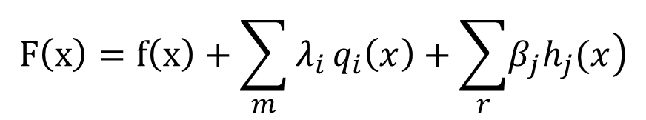

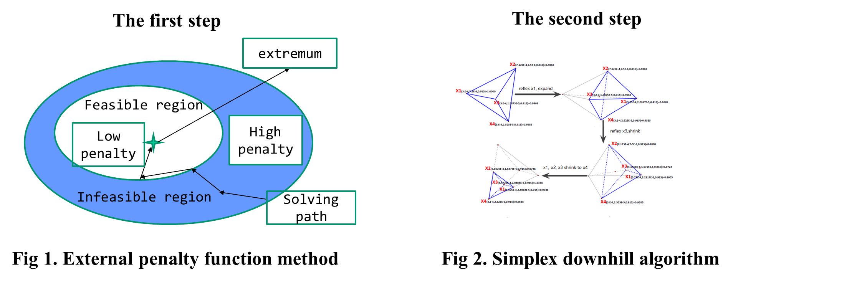
A New Method
Notes:
增广函数

Slide 7
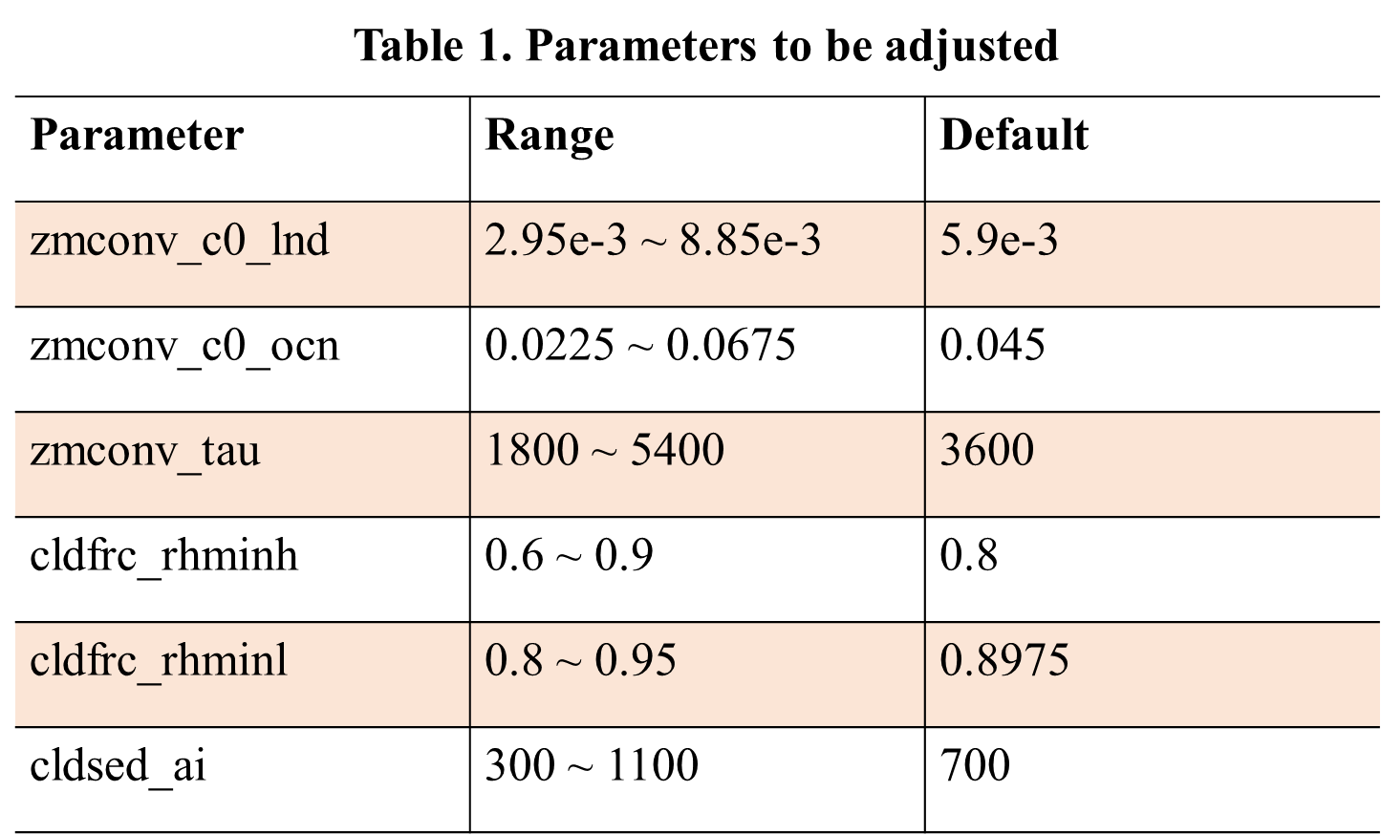
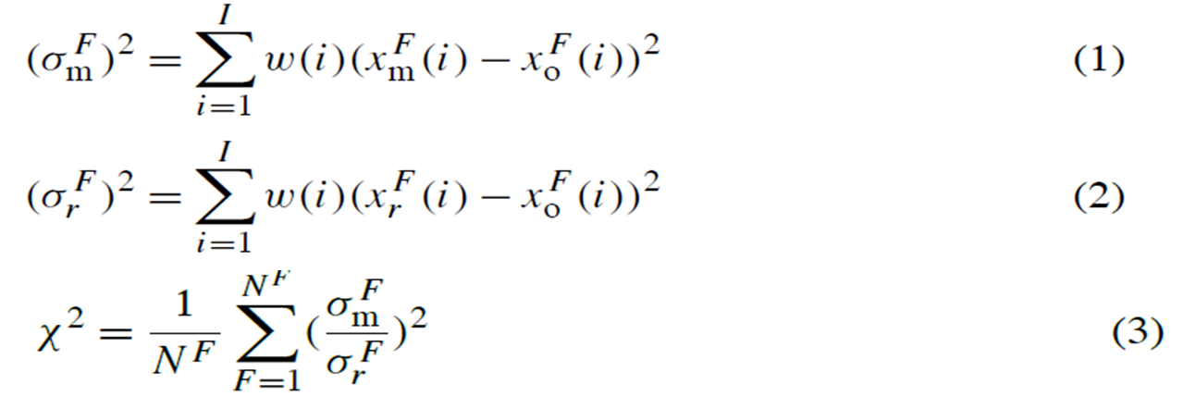

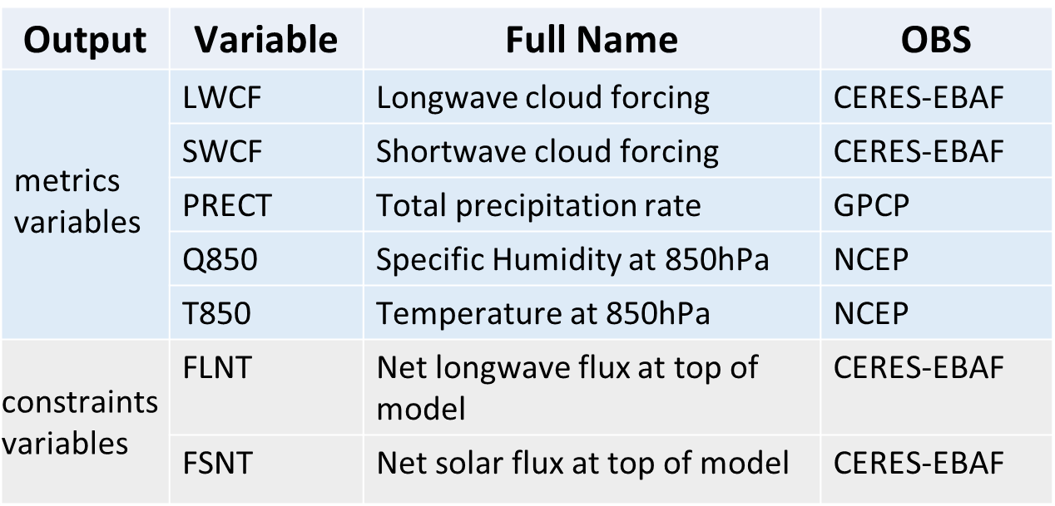

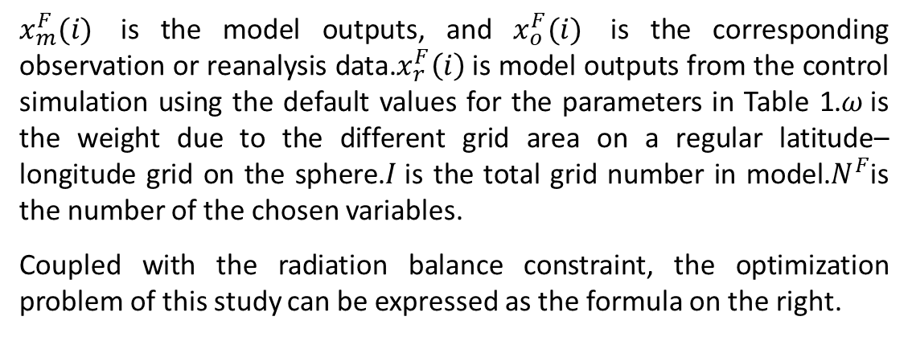
CESM_CAM--Experimental Setup
Each iteration is a 5-year AMIP simulation with a resolution of 2 degrees from 2000 to 2004 in CAM5, and the output of the climatology in last three simulated years is used to calculate synthesized metrics and constraint in our experiment.
$${ABS(FSNT}_{m}−{FLNT}_{m})<1$$
$x_{m}^{F}(i)$ is the model outputs, and $x_{o}^{F}(i)$ is the corresponding observation or reanalysis data.$x_{r}^{F}\left(i\right)$is model outputs from the control simulation using the default values for the parameters in Table 1.$ω$is the weight due to the different grid area on a regular latitude–longitude grid on the sphere.$I$is the total grid number in model.$N^{F}$is the number of the chosen variables.
Coupled with the radiation balance constraint, the optimization problem of this study can be expressed as the formula on the right.

Slide 8
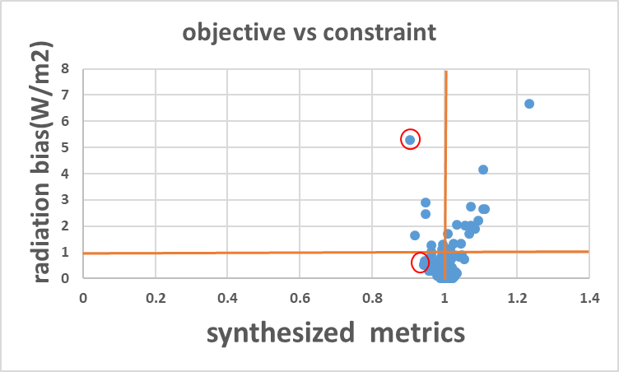
CESM_CAM--results
Notes:
Cnt-flfs=0.6812

Slide 9
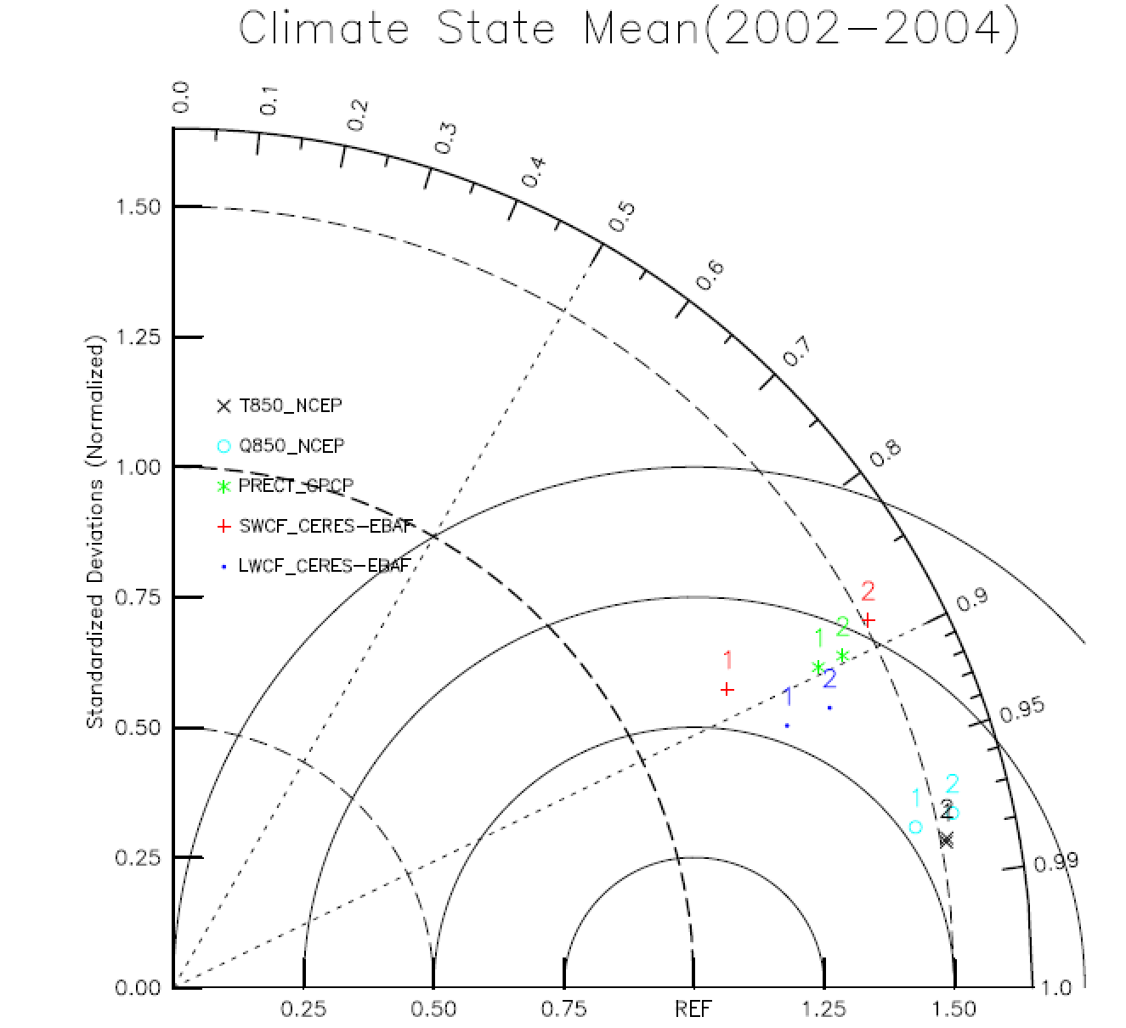
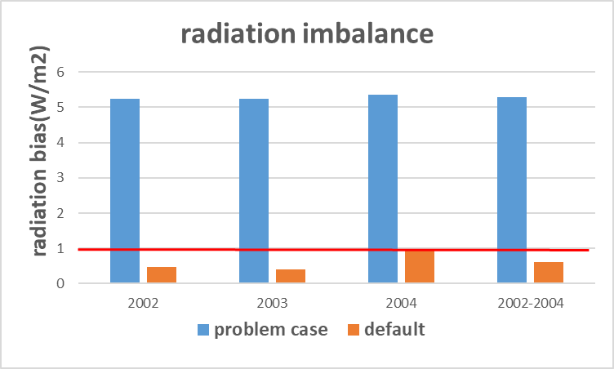
CESM_CAM—problem case
At the beginning of the iteration of the optimization algorithm, we will also find that in some cases the synthesis target is particularly good but does not satisfy the radiation balance constraint. For example, in the following example, the overall goal is optimized by about 10%, but the radiation deviation is more than 1W/m2.

Slide 10
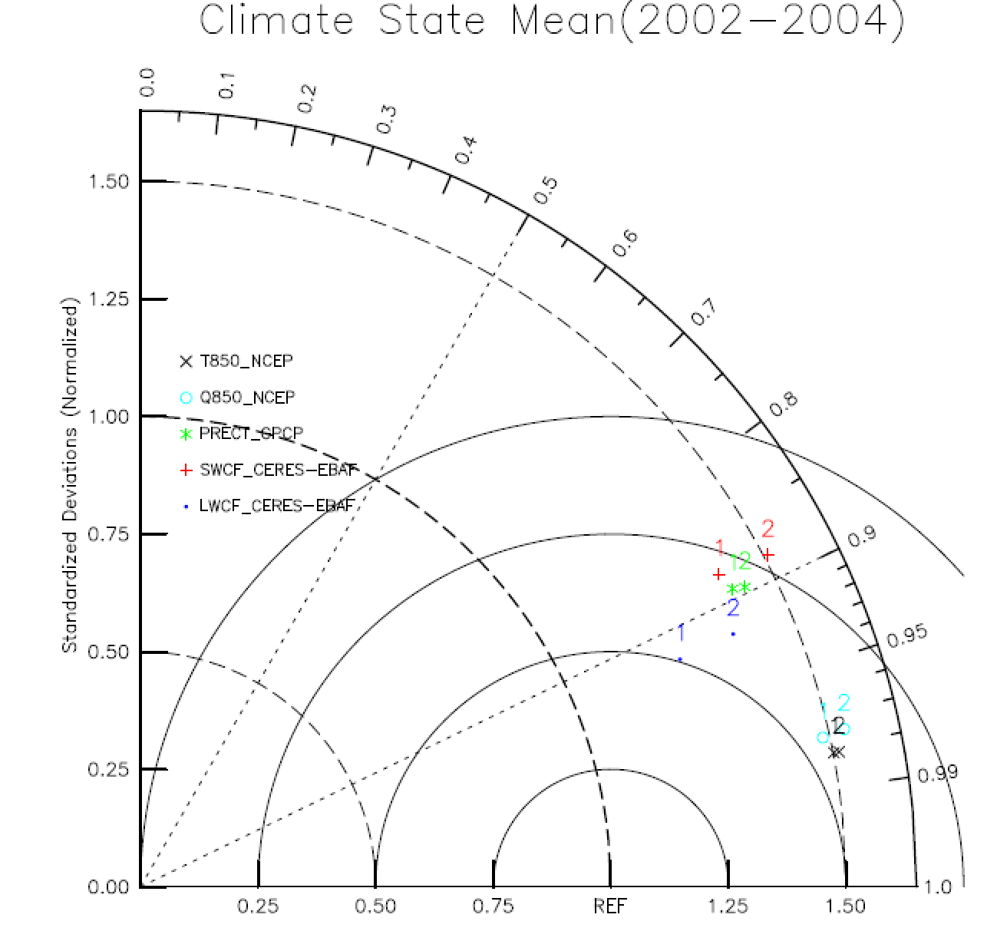
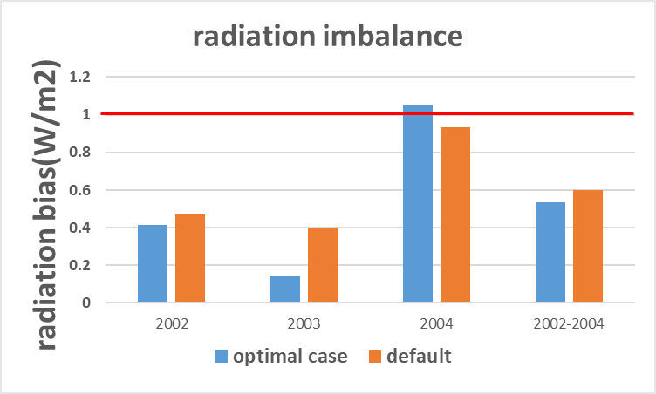
CESM_CAM—optimal case
 | DEF | OPT
synthesized metrics | 1 | 0.945473
ABS(FSNT-FLNT) | 0.6006 | 0.5352
The overall improvement after the tuning from the control simulation can be found in the Taylor diagram, with improvement for almost all the variables, especially for the longwave cloud forcing.
Notes:
bias, as absolute percentage difference from observations
variance, as a ratio of the observed variance
correlation, correlation coefficient with observations

Slide 11
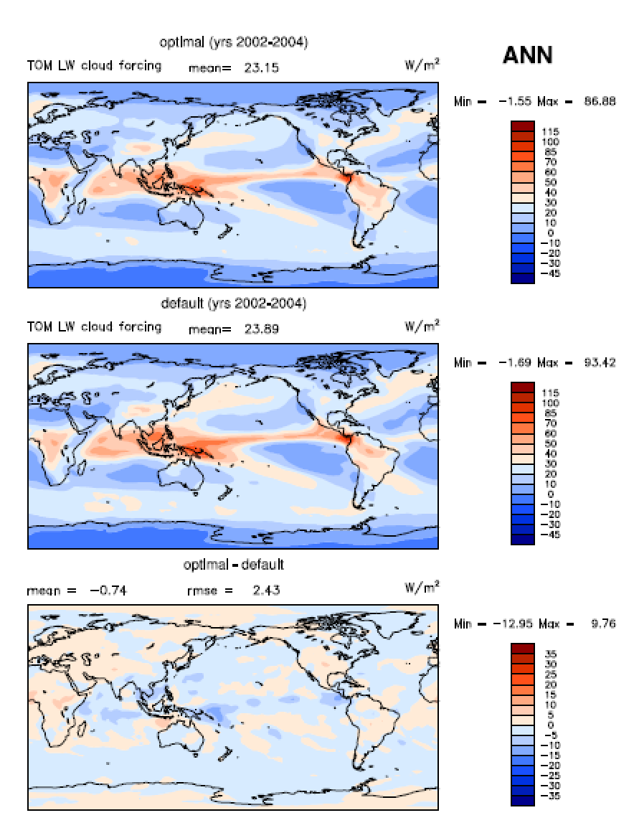
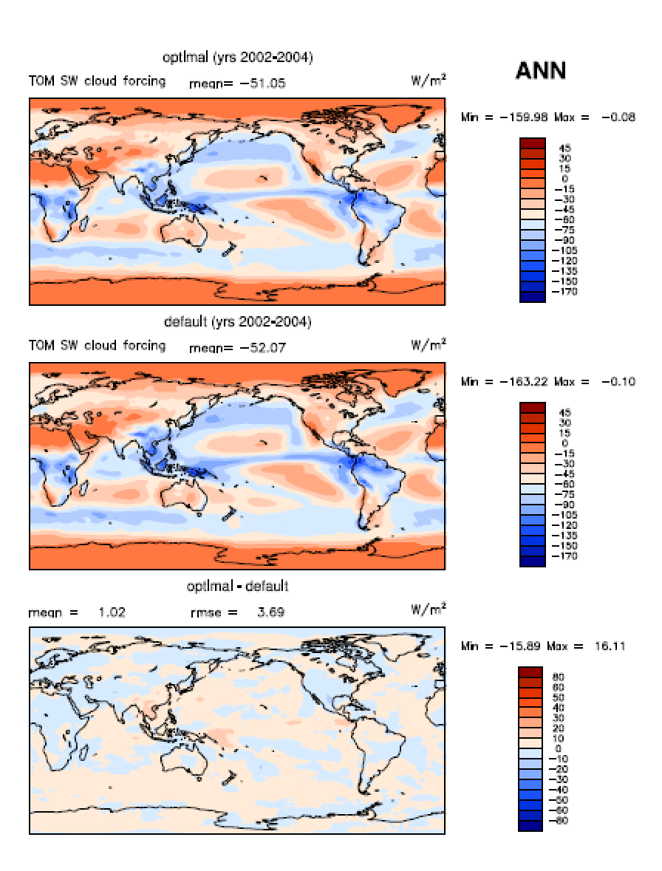
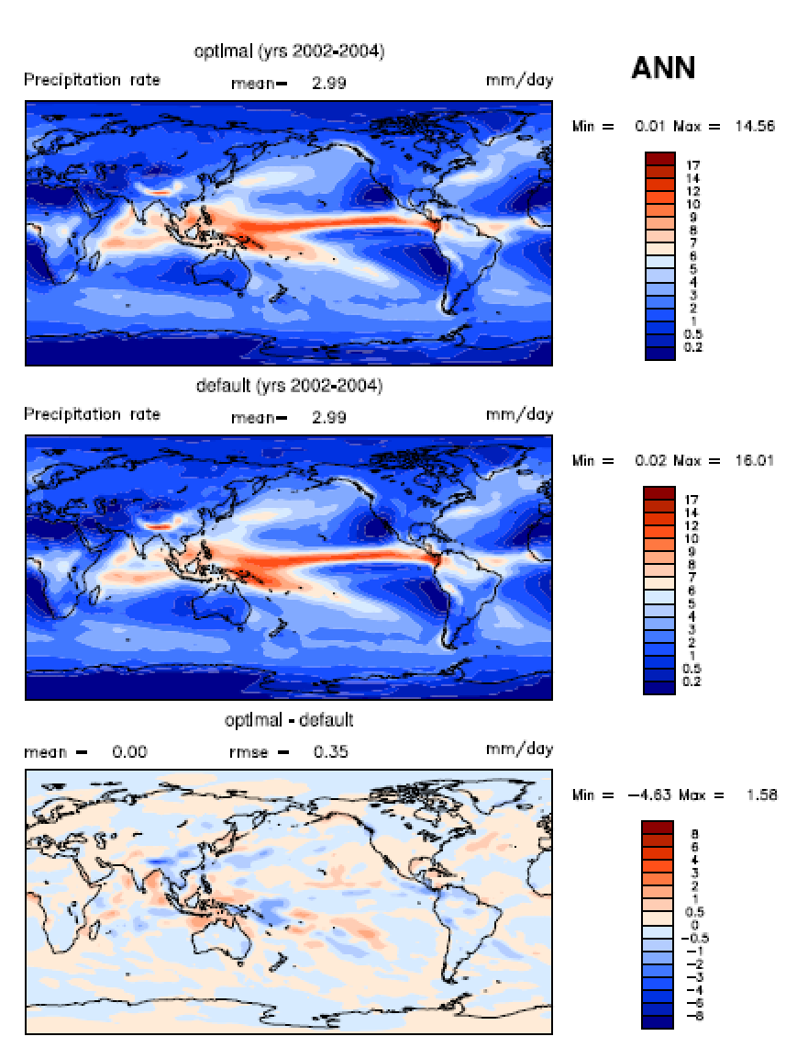
CESM_CAM—optimal case
Detail comparison of different output variables between the simulation with optimal parameters and control run

Slide 12
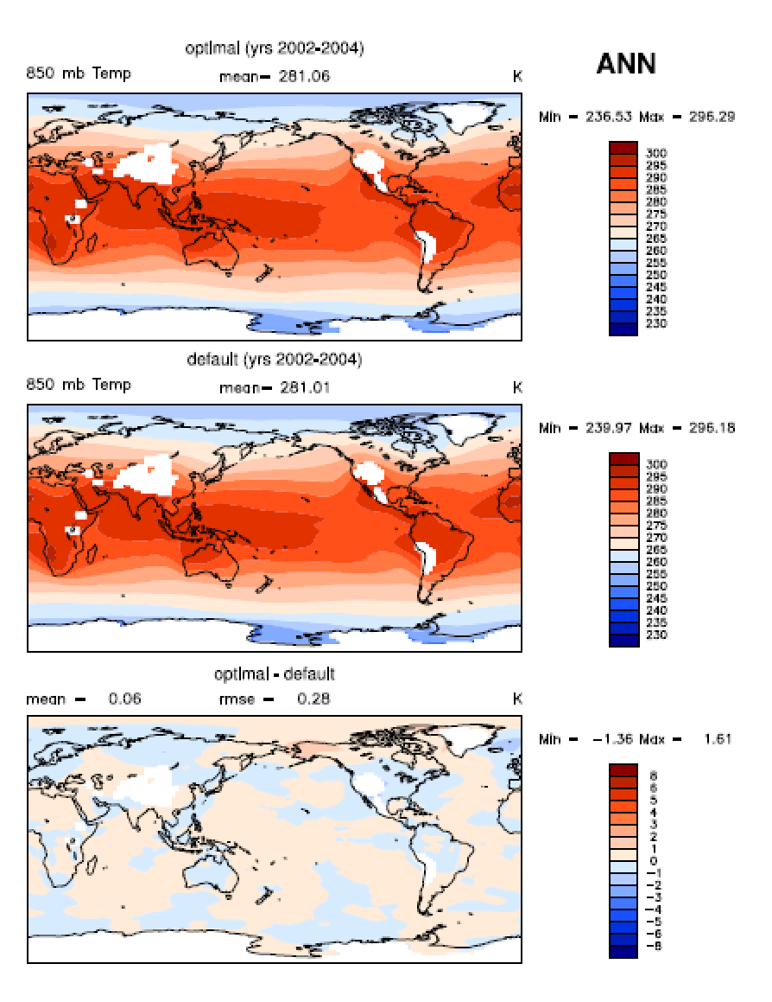
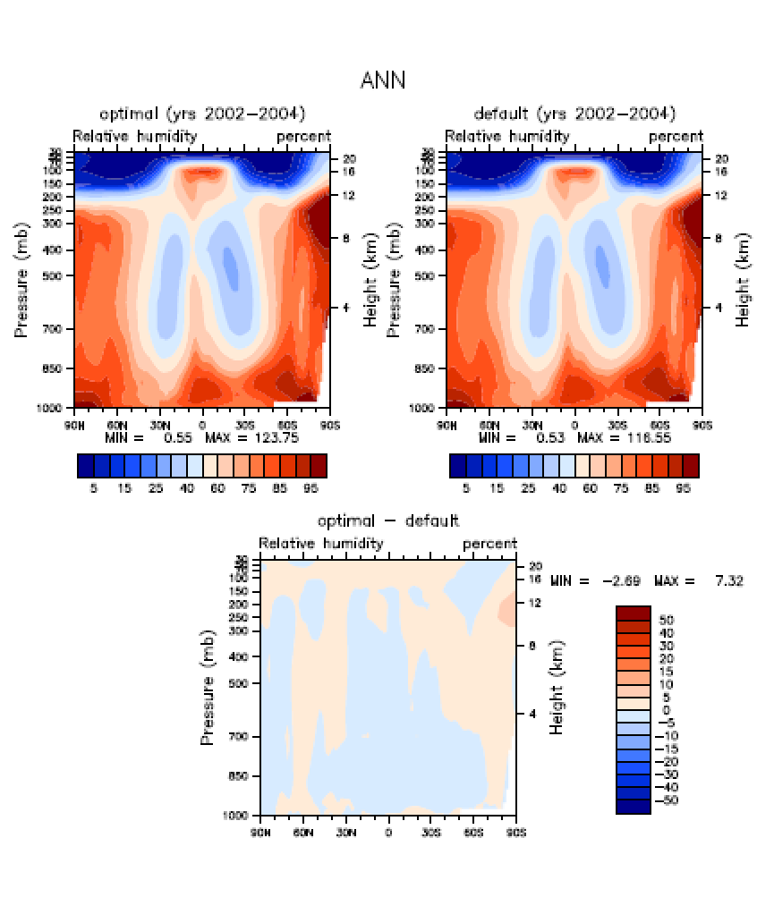
CESM_CAM—optimal case
Detail comparison of different output variables between the simulation with optimal parameters and control run

Slide 13
Thank you very much
吴利

